Slide 1

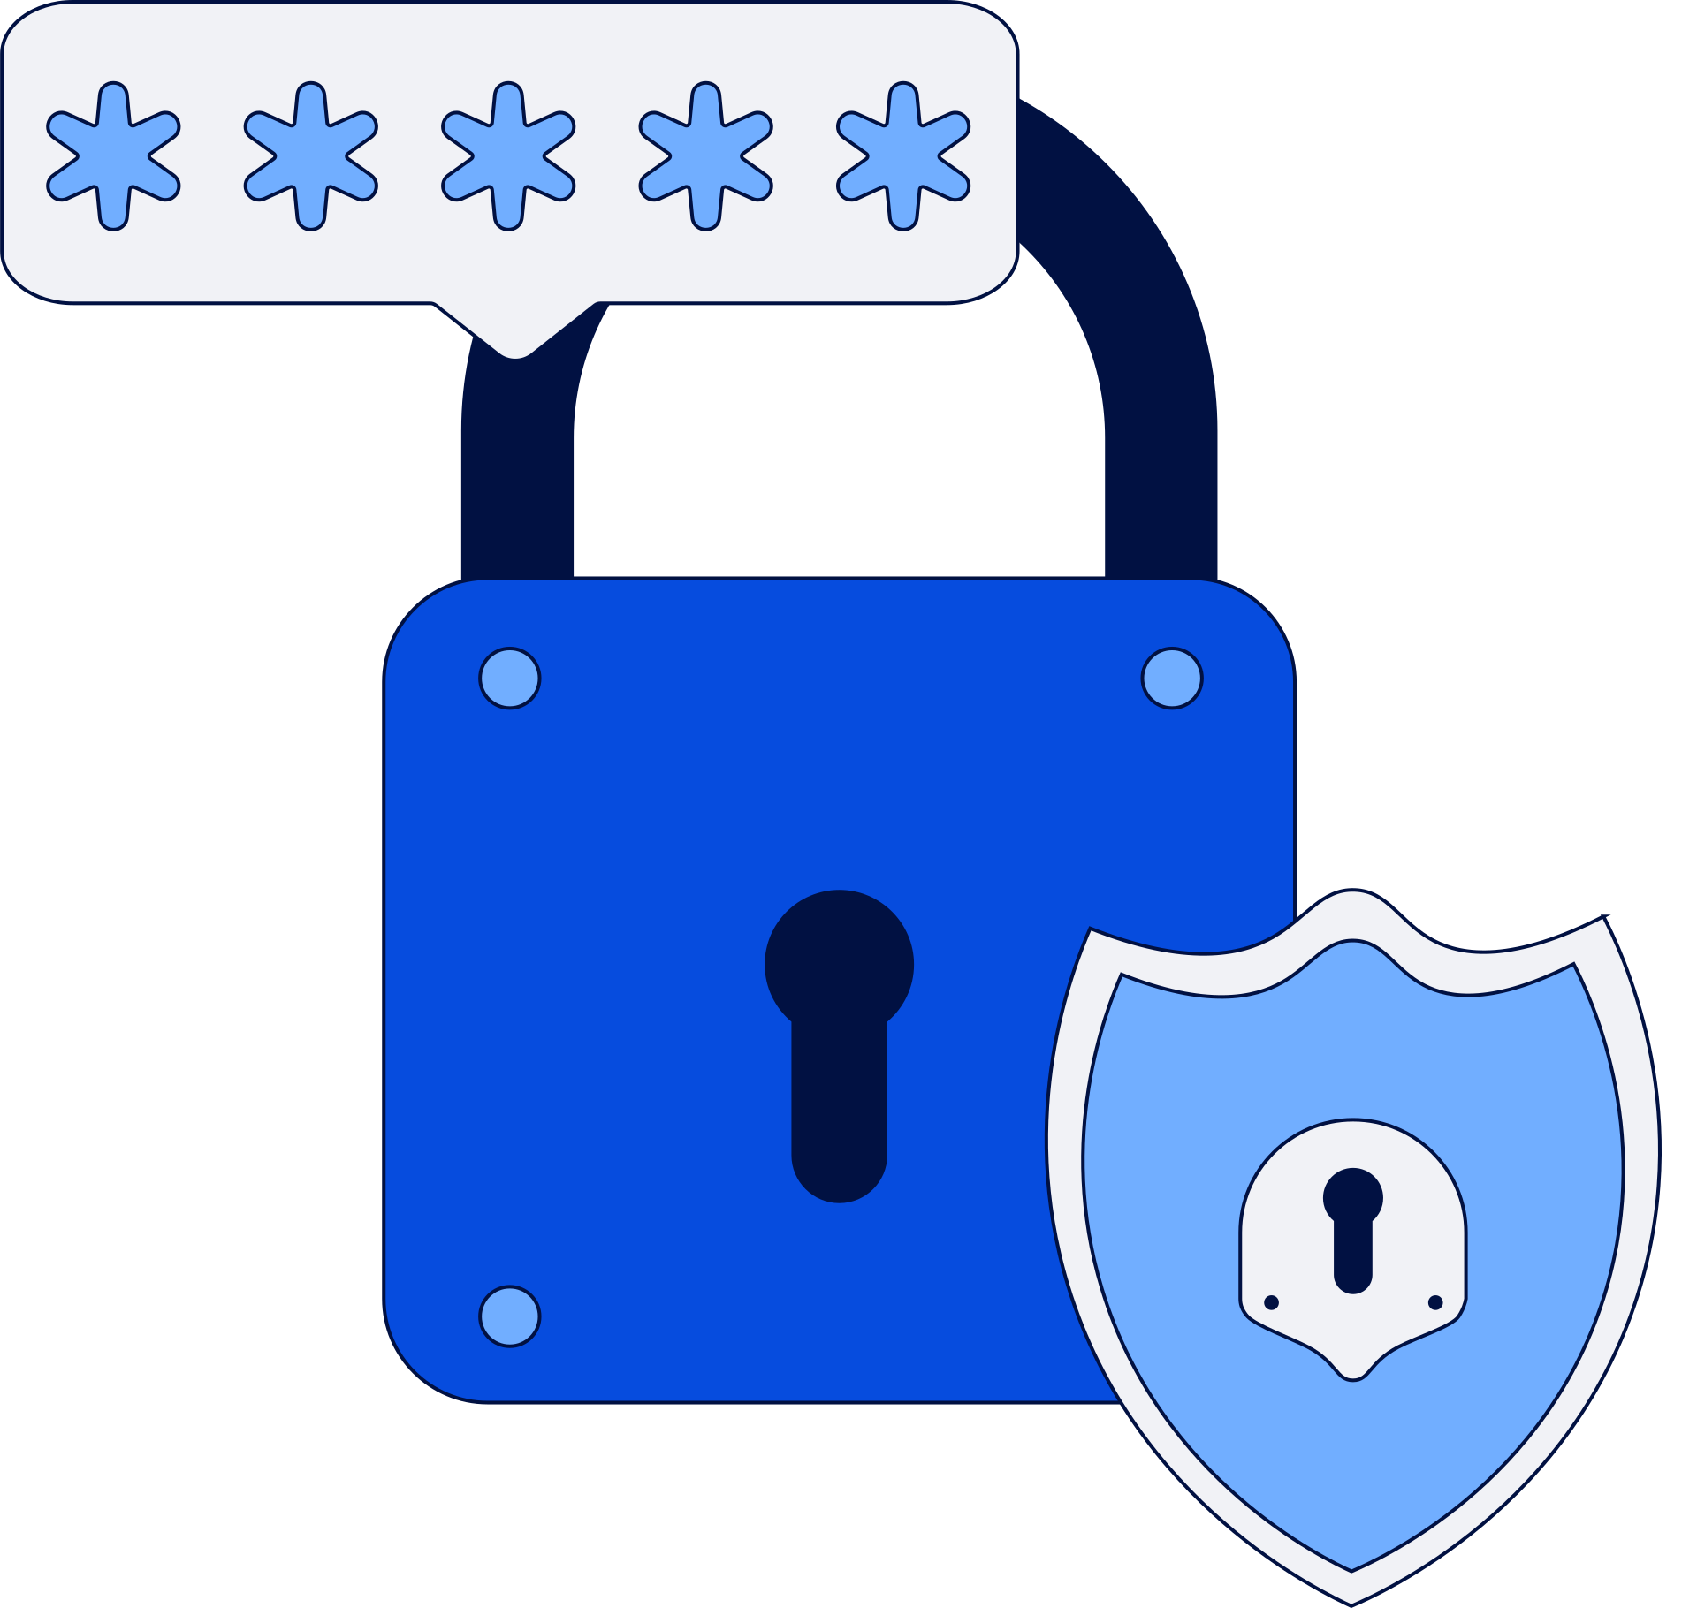

CyberSheild
Cyber Threat
Analyzer
An Introduction to Cyber Threats and
AI-Driven Detection Systems
Dive Deeper

Slide 2

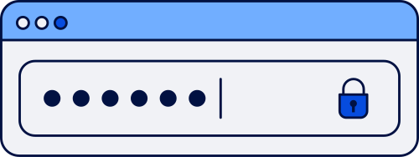
CyberSheild
Introduction:
Cyber threats are growing exponentially, affecting individuals, businesses, and governments worldwide.
Cybersecurity is crucial to protect sensitive data, maintain trust, and ensure uninterrupted digital operations.
Our project: AI-enabled Cyber Threat Analyzer — detects, predicts, and prevents cyber attacks in real-time.

Slide 3


Problem Statement
Increasing Cyber Threats: Modern attacks are more sophisticated, frequent, and damaging.
Limitations of Traditional Systems: Conventional security tools are often reactive, not predictive.
Data Breaches & Loss: Sensitive information of individuals and organizations is at constant risk.
Lack of Real-Time Intelligence: Organizations struggle to detect anomalies before damage occurs.
Need for AI-Driven Solutions: Proactive monitoring and intelligent detection are essential to stay ahead of threats.
CyberSheild

Slide 4



Proposed Solution
CyberSheild
1. What We Offer
AI-powered system to detect, predict, and prevent cyber threats in real-time.
Intelligent dashboard for easy monitoring and reporting.
2. How It Works
Data Collection: Monitors network and system activities continuously.
AI Analysis: Uses machine learning to identify unusual patterns or anomalies.
3. Why It’s Unique
Proactive Defense: Stops threats before they cause harm.
Adaptive Learning: System improves over time by learning from past threats.
Scalable: Can be deployed for individuals, businesses, or government networks.

Slide 5
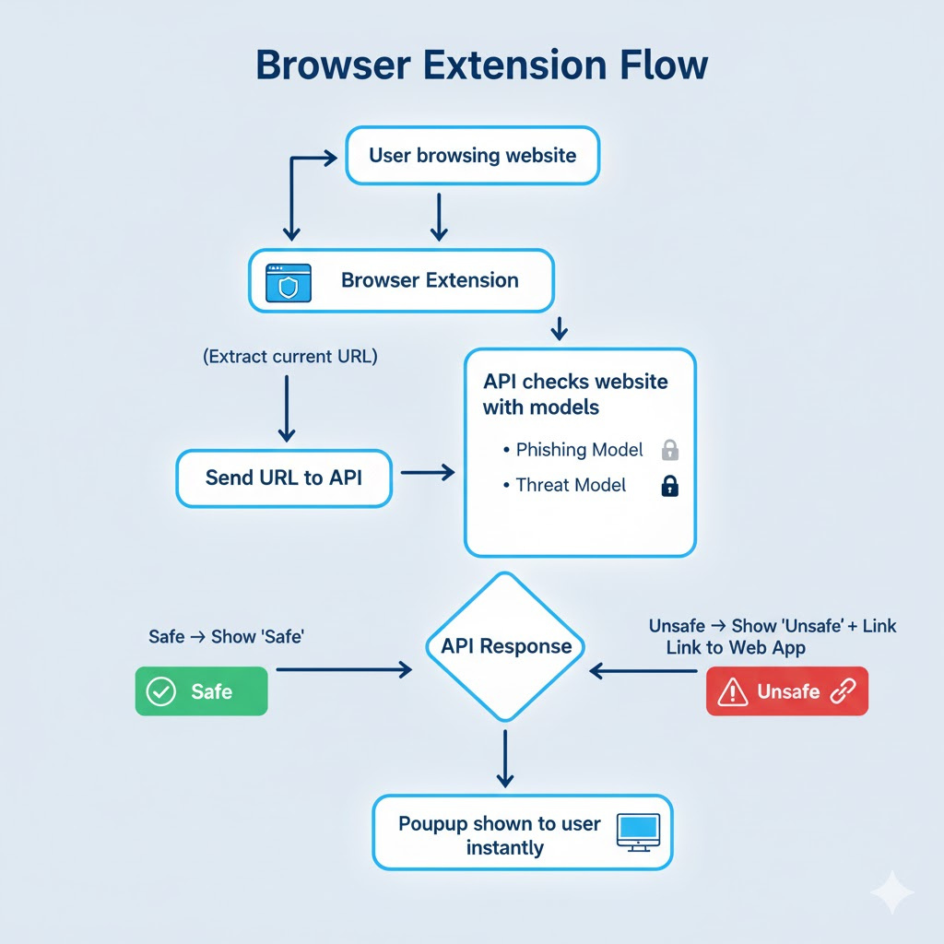
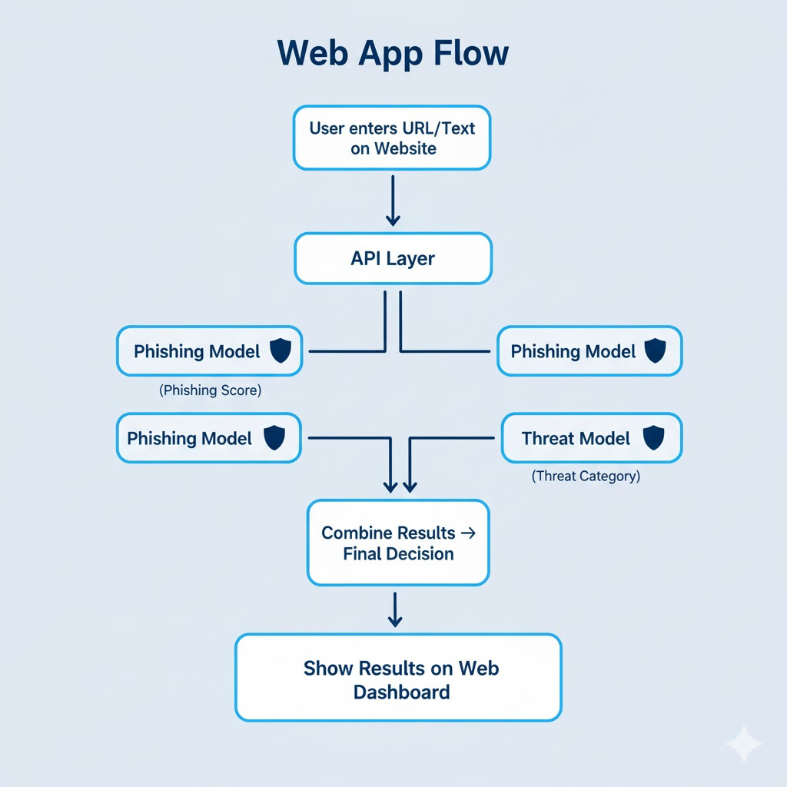
System Architecture / Workflow
CyberSheild

Slide 6


Features And
Technology Stack
CyberSheild
1.Features:
Real-time threat detection and alerts
AI-powered analysis & predictions
User-friendly dashboard & reports
Scalable for individuals & organizations
2. Technology Stack
Programming Languages: Python.
AI/ML Models: supervised learning algorithms(logistic regression)
Database & Storage: SQL / NoSQL
Frameworks & Libraries: Scikit-learn.
Web & Dashboard: HTML, CSS, Streamlit.
APIs & Integrations: REST APIs for data ingestion and notifications
Deployment: local servers

Slide 7
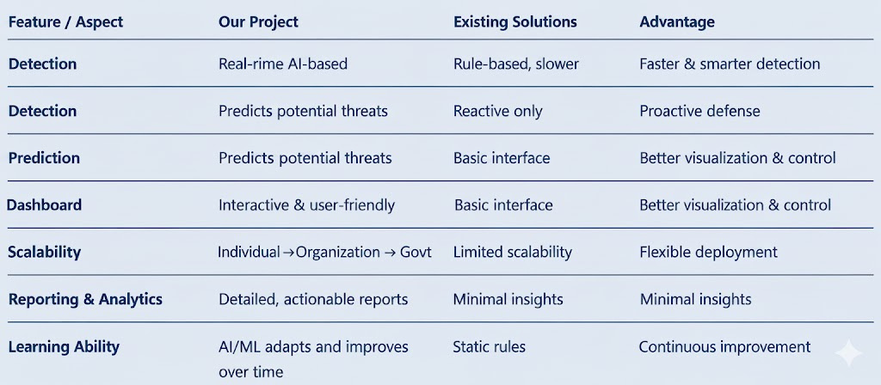

Comparison & Advantages
CyberSheild

Slide 8





Business Model Practical Application
&
CyberSheild
1.Target Users / Applications:
Government Agencies: Real-time monitoring & national cybersecurity.
Organizations / Enterprises: Protects sensitive business data and networks.
Individuals / SMEs: Secures personal and small-scale digital assets.
2. Practical Benefits:
Proactive threat detection and prevention.
Real-time alerts for fast response.
Scalable and adaptable across sectors.
3. Funding & Support Needed:
Approx ₹1.5–2 Lakh for:
Server setup and API hosting
Mobile app development tools & licensing
Model optimization for real-time AI inference
Mentorship / Guidance: Cybersecurity experts for validation and improvement

Slide 9



CyberSheild
Conclusion
Our AI-enabled Cyber Threat Analyzer provides real-time detection and prevention of cyber threats using intelligent AI and user-friendly dashboards. It ensures secure, scalable, and reliable protection for individuals, organizations, and governments
(Shall we present a live demo)

Slide 10
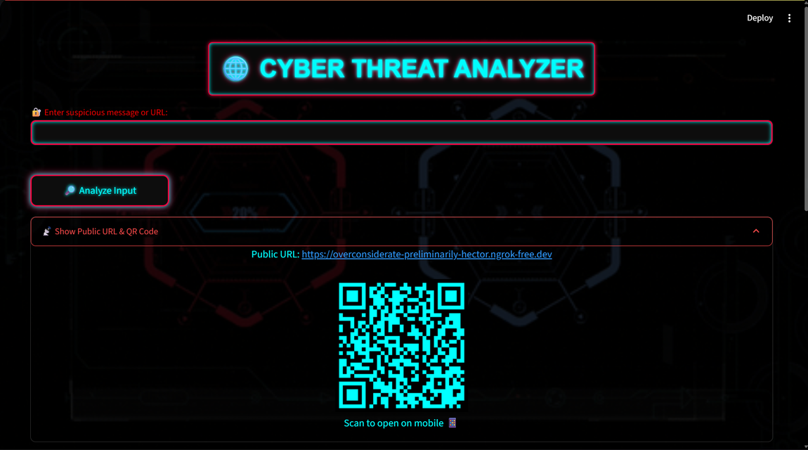
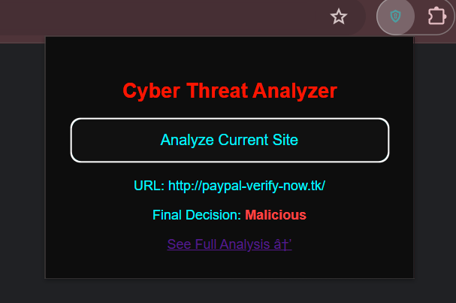
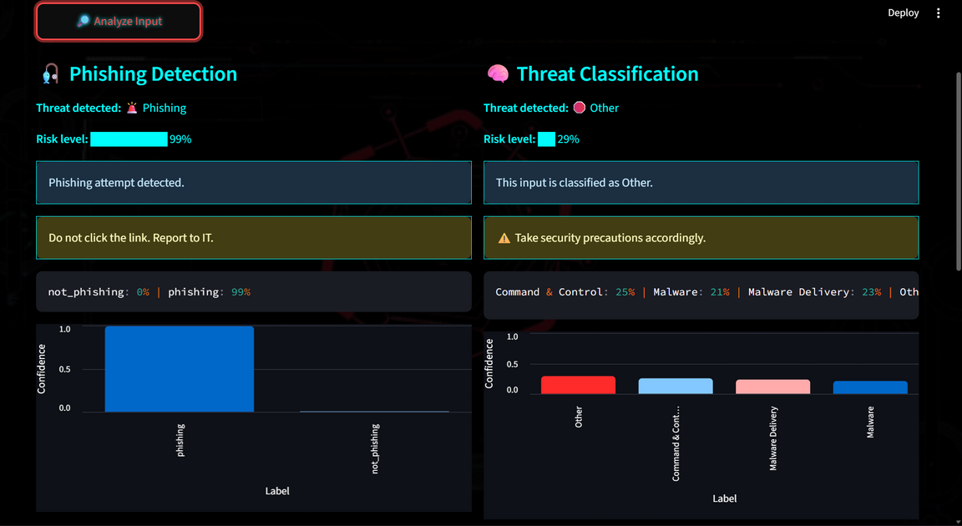
CyberSheild
Demo / Screenshots
Img-2
Img-1
Img-3
Img-1: browser extension
Img-2:web page
Img-3:classification results.

Slide 11

RESEARCH AND REFERENCES
1.S. Pastrana, D. R. Thomas, A. Hutchings, and R. Clayton, “Crimebb: Enabling cybercrime research on underground forums at scale,” pp. 1845–1854, April 2018.
2. Ahmed, S. and M. Skoric (2015). Twitter and 2013 Pakistan general election: The case of David 2.0 against goliaths, pp. 139–161. Springer International Publishing.
3.Almohri, H. et al. (2017) ‘On Threat Modeling and Mitigation of Medical CyberPhysical Systems’, Proceedings - 2017 IEEE 2nd International Conference on Connected Health: Applications, Systems and Engineering Technologies, CHASE 2017, pp. 114–119. doi: 10.1109/CHASE.2017.69.
4. Patil, P., Artificial intelligence in cybersecurity. Inter rnational journal of research in computer applications and robotics, 2016. 4(5): p. 1-5.
5.Andress, Jason and Steve Winterfeld. 2011. Cyber Warfare: Techniques, Tactics and Tools for Security Practitioners. Waltham, MA: Syngress Elsevier.
Thank You

